Slide 1
Customer Prediction Model: Accuracy and Performance
Overview of customer prediction model performance, demonstrating key metrics and insights.
DS
by Damilare Segun

Slide 2
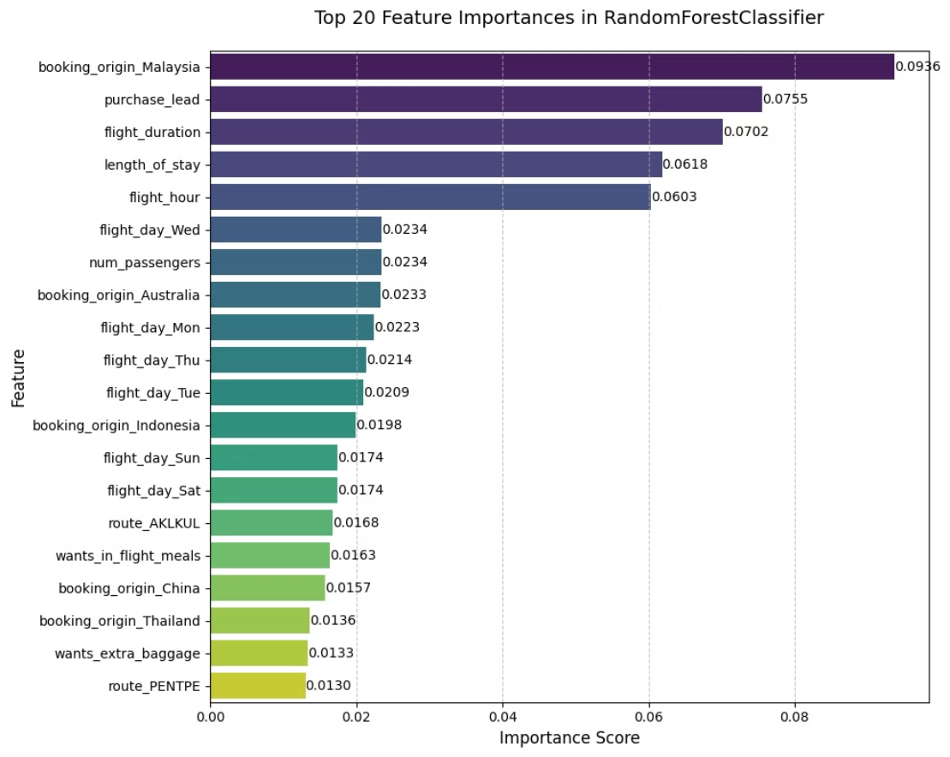

Slide 3
Model Performance Metrics
Accuracy
Precision
Recall
F1-Score
0.8419
Class 0: 0.87
Class 0: 0.95
Class 0: 0.91
Class 1: 0.44
Class 1: 0.20
Class 1: 0.28

Slide 4

Results and Next Steps
1
High Accuracy
2
Class Imbalance
3
Next Steps
The model demonstrates strong overall accuracy, indicating its ability to correctly classify customers.
Notable class imbalance impacts precision and recall for Class 1, indicating potential need for further refinement. I used bootstrapping as part of my hyperparameter tuning.
Further analysis, data exploration, and potential model adjustments to address class imbalance and enhance predictive power.

Slide 5
Results
Model Accuracy: Strong overall performance at 84.19%, indicating reliable customer predictions for most cases
Booking Prediction Success: Initial recall rate of 20% for identifying potential bookings, significantly improved to 55% through advanced Balanced Bagging Classification techniques
Key Predictive Indicators: Two features emerged as strongest predictors: purchase_leadflight_duration (time between purchase and flight), and last_minute_booking (tendency for late bookings)
💡 Business Impact
Targeted Marketing Opportunities: Enable precise customer segmentation to deliver personalized offers at optimal timing, potentially increasing conversion rates through behavior-based messaging
Revenue Optimization Strategy: Leverage insights about booking patterns and timing to adjust pricing and promotion strategies, focusing resources on customers most likely to convert

